Slide 1



ASEE Meeting
Lightweight Innovations for Tomorrow (LIFT)
Washington, DC
January 25, 2016

Slide 2

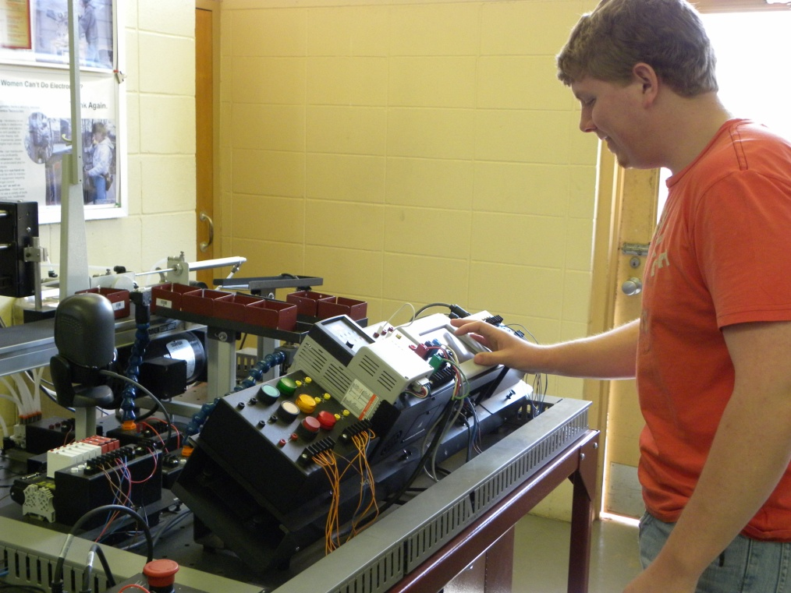

NSF Advanced Technological Education
Educating technicians for the high-tech fields that drive our nation’s economy
Notes:
WELCOME EVERYONE!! – ROUND THE ROOM INTRODUCTIONS
AIDT – ROD JONES DON LEU – Chairman IAC
Agenda in folder – Follow as closely as possible but we will be flexible and adjust as we need to

Slide 3


Alabama - Plan 2020
Our goal is to increase the number of graduating students who are college & career ready & build the ideal employee for the 21st Century
Notes:
STATE Dept. of Education PLAN TO PRODUCE GRADUATES WHO ARE CAREER READY – CARCAM’S MISSION WORKS WITH THIS STATE PLAN

Slide 4
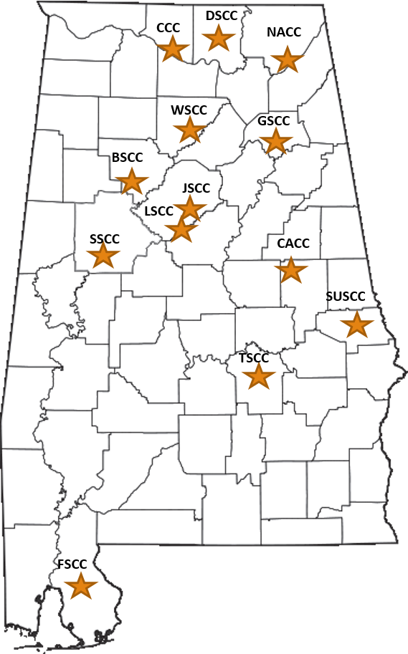
CARCAM Educational Network
Bevill State
Calhoun
Central Alabama
Drake State
Faulkner State
Gadsden State
Jefferson State
Lawson State
Northeast State
Shelton State
Southern Union State
Trenholm State
Wallace State Community College - Hanceville
Notes:
Network of colleges throughout the state

Slide 5
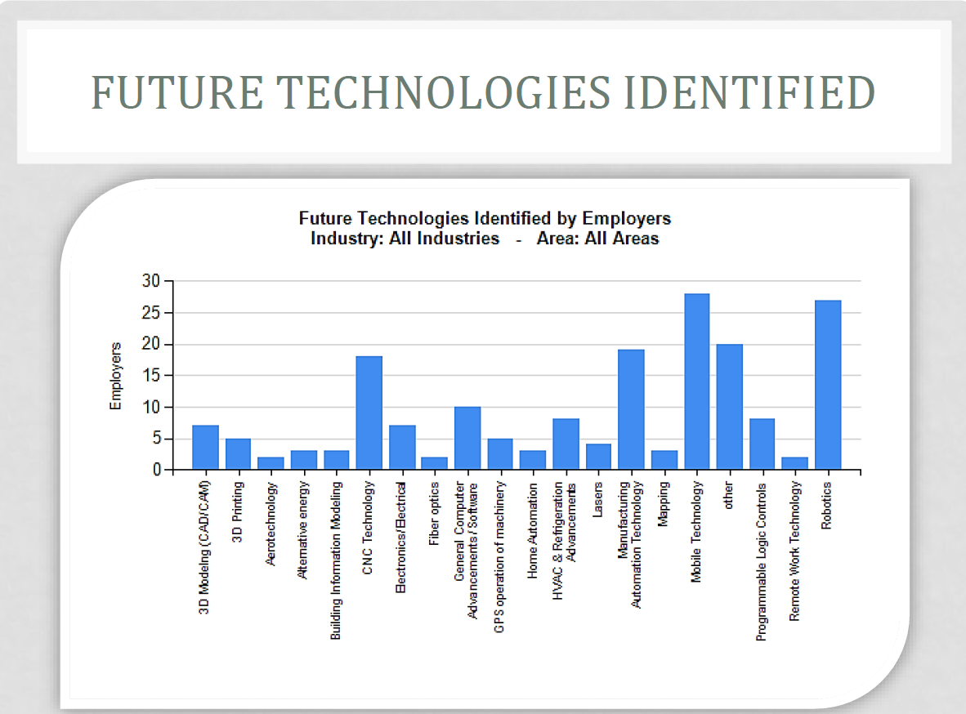

Notes:
ALABAMA DEPT OF LABOR STATS
Within the state these are some of the future technologies identified as important to employers --- Robotics, CNC Technology, manufacturing automation technology

Slide 6
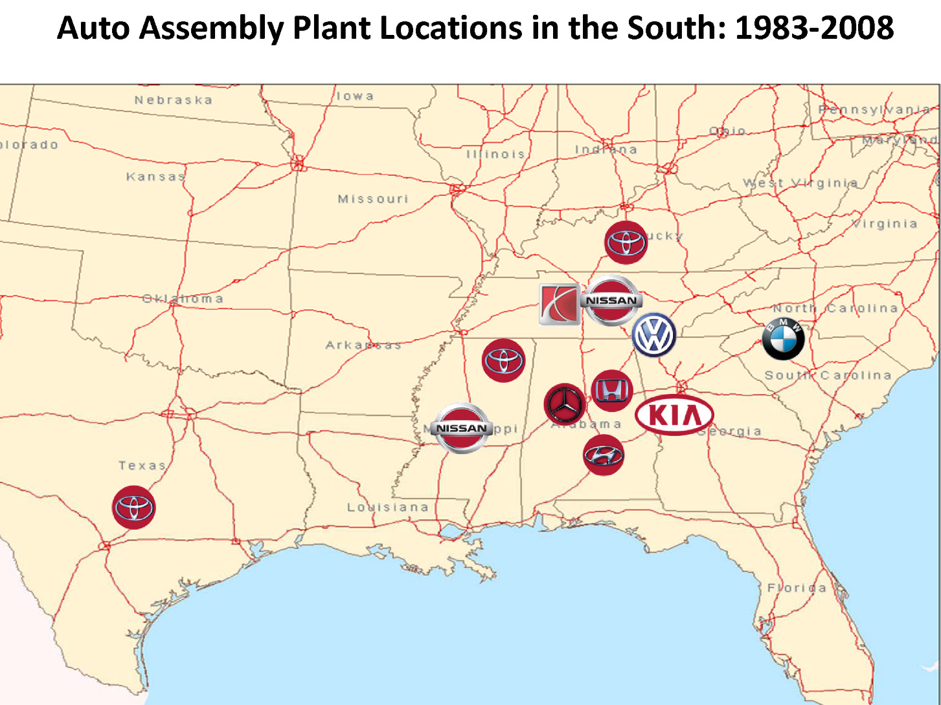
Southern Automotive Corridor

Slide 7
Dept. of Labor Grant
Multi-State Advanced Manufacturing Consortium www.msamc.org
Notes:
CARCAM/GSCC is one of thirteen colleges in 9 states participating. The grant’s mission is to improve manufacturing education to better align with industry and student requirements with a focus on three manufacturing industries – process, automotive/transportation, and aerospace/parts and precision manufacturing.
Through this grant we were able to purchase a new multi-system trainer designed by FANUC for mechatronics education – along with other initiatives – next slide

Slide 8
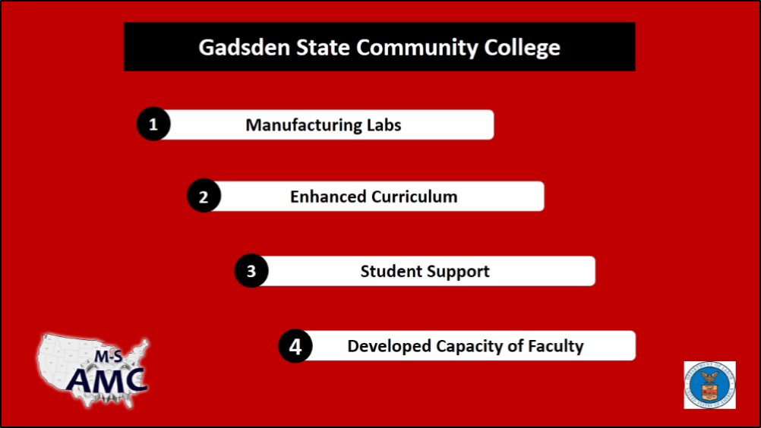
MS AMC GRANT ACTIVITIES & OUTCOMES
Notes:
4 MSAMC strategies
Better equipped labs that align more with what industry NEEDS
Purchased AMTEC online modules as well as Immerse 2 Learn to enhance current curriculum
Provided students with the opportunity to earn nationally-recognized credentials-- National Career Readiness Certificates (NCRC) by funding Workkeys test fees
Provided SELECT Professional Development for instructors:
Cognex
FANUC
Control Logix
OSHA NFPA 70E
Integrated Systems Training on AMTEC trainer

Slide 9
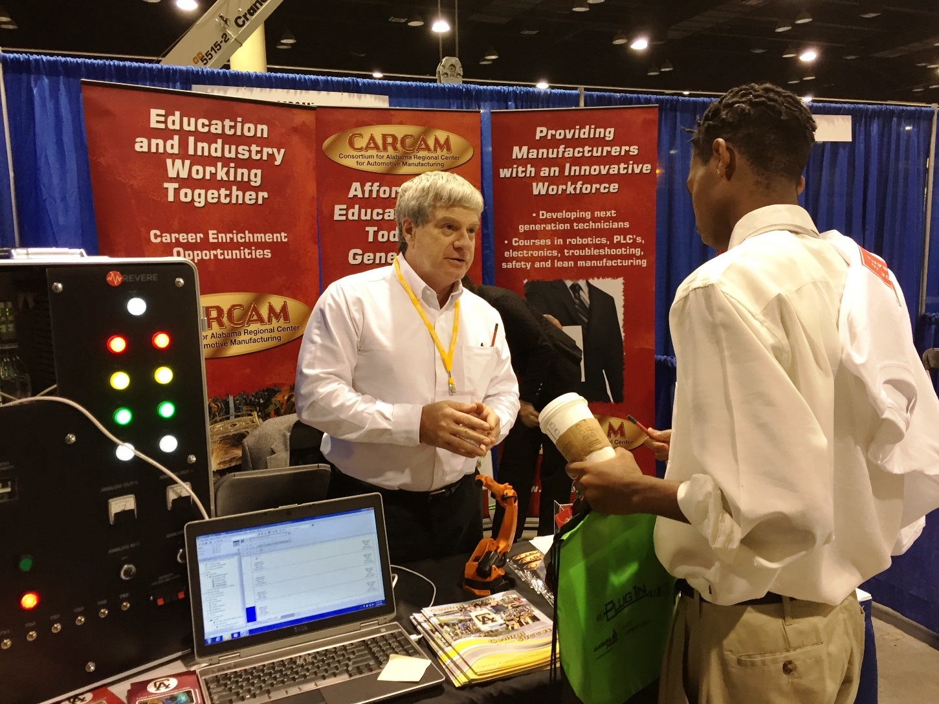
Dissemination at National Events
Notes:
Recruitment for students into Technical or STEM careers – This is a Secondary Education event – CARCAM Participated as a sponsoring and hosted a booth at this Fall’s JLDC conference in Birmingham – 8000 H.S. students attended from 425 schools, had 111 companies to participate

Slide 10

AMP It Up! – Highlights & Updates
Mission Statement
CARCAM responds to rapid regional and national advanced manufacturing sector growth by developing and implementing innovative methods to: recruit and educate a highly-skilled diverse technician workforce and provide state-of-the-art professional development for faculty.

Slide 11
CARCAM Goals
AMP It Up!
Goals:
1) Advance CARCAM’s mission as the Regional ATE Center for comprehensive, industry-recognized workforce development and STEM learning
2) Establish CARCAM as the industry liaison with the Alabama Department of Education and the Alabama Community College System developing a seamless career pathway encompassing a modern, statewide, holistic approach to skills and knowledge development
3) Enrich multi-system technician education levels with an innovative and flexible approach to stackable credentialing--to meet evolving industry sector and economic needs
4) Deliver faculty and staff professional development workshops/academies that address emerging technologies, advanced manufacturing and workforce trends

Slide 12
Alabama Automotive Manufacturing
Technology Associate Science Degree
I. General Education – 22 credit hours
    English/Speech Science
    Math Social Science
    Humanities/Ethics Microcomputer Applications
General Education – 15 - 18 credit hours
II. AUT Core - 21 credit hours
Automotive Concepts Electronics/AC/DC
Lean Manufacturing/Safety Blue Print Reading
Robotics Programmable Logic Controllers
II. ET Core - 18 credit hours
III. Specialization Tracks: 21-33 credit hours
  Drafting
  Machining
  Electronics
  Welding
  Industrial Automation
10 Specialization Tracts – 24 to 27 credit hours
Total: 64-76 hours
Notes:
Each college provides some form of this degree
Typical Associate of Science Degree – has courses that can be divided into 3 areas
Gen Ed
Technology Core
Technical specialization

Slide 13
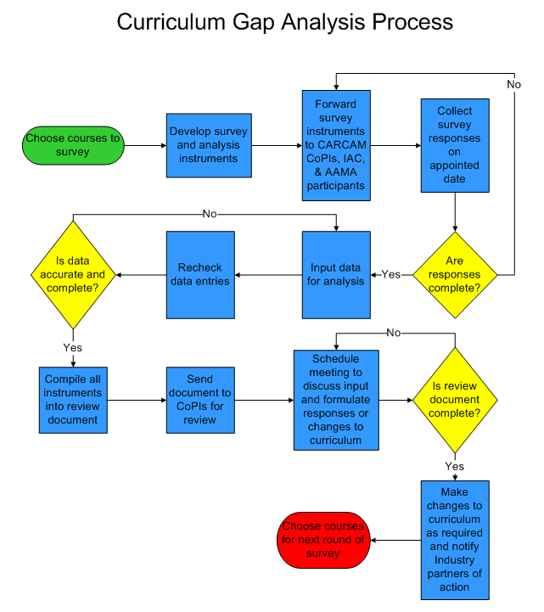

Slide 14
ENROLLMENT TRENDS in AUT and Related Courses
Notes:
Enrollment is steadily increasing according to data reports –technical programs enrollment is increasing – trend is still to increase

Slide 15
DATA - LEVERAGED FUNDING 2014-15
Estimated dollar amount of leveraged funding and in-kind support from other sources (not including NSF) for CARCAM programs.
$2,537,651
Estimated dollar amount of leveraged instructional equipment/facilities /materials via collaborative efforts with industry, partner colleges, or governmental partners.
$2,016,564
Total Leveraged Funding (2014-15)
$4,554,215
Total to Date – 2005-2015
$25,255,871

Slide 16
Amp It Up! Grant Initiatives
Seamless career pathways with K-12 education and university transitions
Professional development, portable credentialing,
credit for prior learning
Emphasis on multi-system technician- Mechatronics
Co-Op/Internship and Apprenticeship programs
Veterans as target audience
Explore emerging technologies, growth trend of aerospace/aviation industry
Collection of hard data on enrollments and
retention, activities impact, job placement
Notes:
Major emphasis now is on working with businesses to establish Co-Op internships or apprentice programs for our students.
Mercedes – very effective
Toyota – new AMT program – in Huntsville area
Southern Union – multi industry DOL apprenticeship

Slide 17
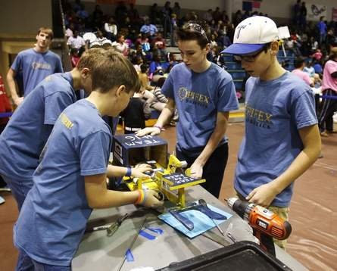
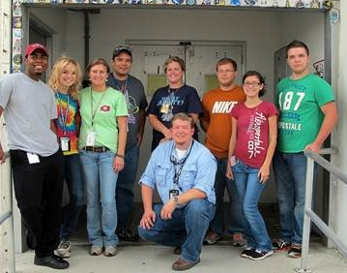
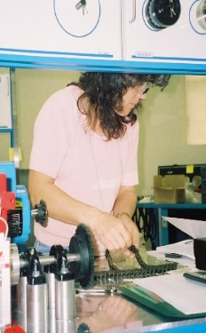
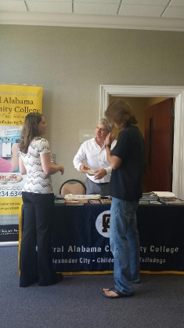
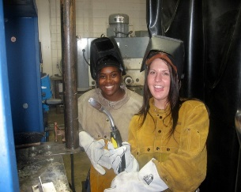
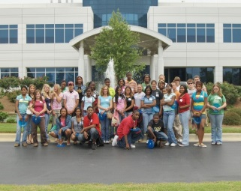
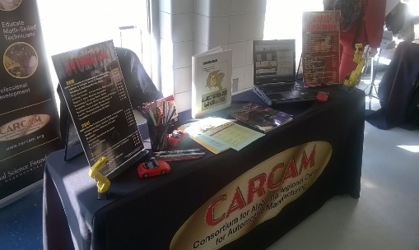
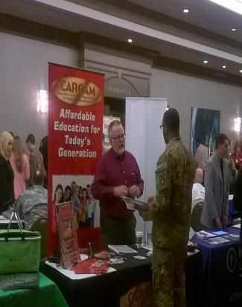
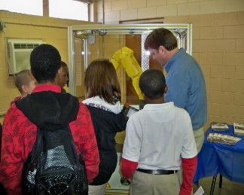
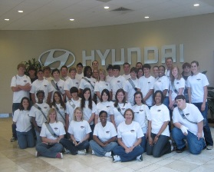
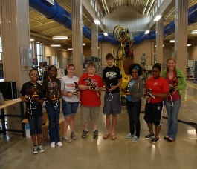

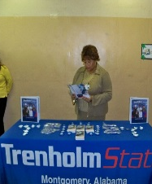
CARCAM STUDENT ACTIVITIES
STEM/Robotics Camps
Best Robotics Competition
Skills USA Competition
National Manufacturing Day
Notes:
NUMEROUS STUDENT ACTIVITIES

Slide 18

Student Scholarships
2015-16
10 Awards - Dr. Bernard J. Schroer (AAMA)
AAMA Scholarships since inception total
49 awards - $373,500
Mercedes - Bill Taylor Award for Excellence - $500
Southern Automotive Women’s Forum - $4750
Notes:
Just SOME OF THE SCHOLARSHIPS THAT CARCAM STUDENTS RECieve – DOESN’T INCLUDE TECHNICAL SCHOLARSHIPS FROM THE INDIVIDUAL SCHOOLS
Data from partner colleges - Examples –, …..AAMA has strongly support our CARCAM college students - $1500 per year (2 semesters - $750 each)
CENTER FACILITATES AAMA ORGANIZATION’S SCHOLARSHIP PROGRAM – AWARDS ARE MADE TO CARCAM COLLEGES ONLY ACROSS THE STATE
As a result of our outreach – we are members of SAWF – a Tennessee organization which gave $33,750 last year to young women in auto related programs – 2 CACC students won this year -
--- LINKS TO SCHOLARSHIP INFORMATION AND APPLICATIONS ON OUR CARCAM WEBSITE

Slide 19
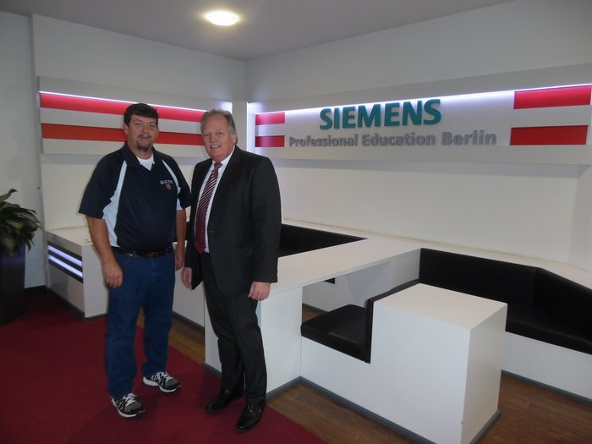
Joe Hendrix (WSCC) Pictured in Germany
Completed the Siemen Mechatronic Systems Certification Program - 2014
Notes:
Mr. Hendrix completed the Level 2 Siemens Certification Training in Berlin at the Academy. WSCC is partnering with the Cullman Area Career Center and offering Mechatronics training. Degree is a combination of Mechanical, Electrical/Electronics and Computers.
2 other CARCAM faculty members have since completed this Siemens Certification in Germany

Slide 20
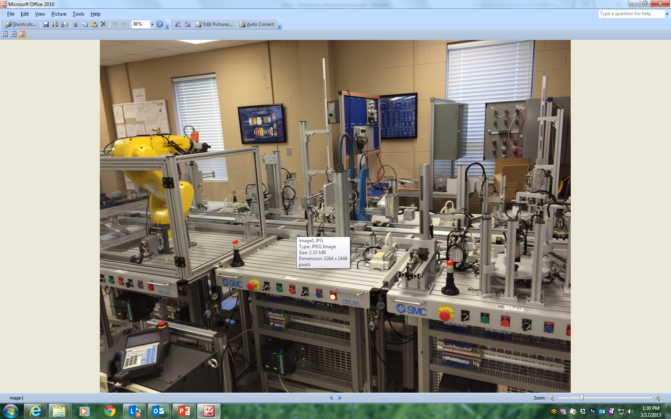
Notes:
NEW SYSTEMS TRAINER AT WSCC – HANCEVILLE --- JOE

Slide 21
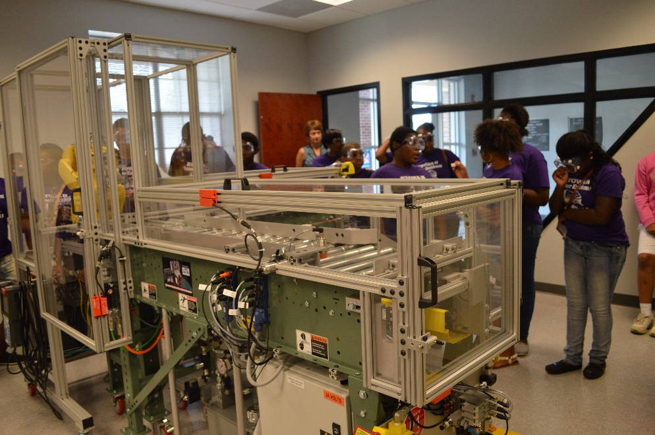
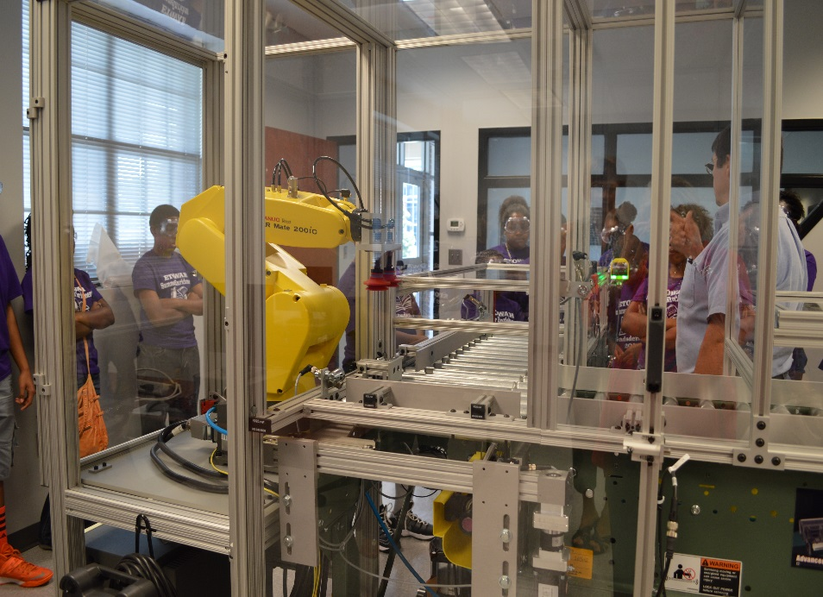
AMTEC Trainer - Integrated Systems
www.msamc.org
Notes:
On line curriculum
New lab equipment – utilized Mini II Spring semester GSCC

Slide 22



























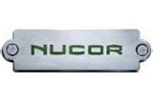



Thankful for our Industry Partners!
Notes:
THANK YOU TO OUR MANY INDUSTRY PARTNERS

Slide 23
CONCLUSION
CARCAM Future Focus
Assess the region’s newest manufacturing priority or need
Examine program objectives to insure relevance for current workplace trends
  Ask - will graduates be able to enter employment at acceptable skill levels?
Expand industry-endorsed, curriculum and programs to integrate emerging technologies to prepare highly-skilled technicians for future changes
Expand collaborative efforts for program sustainability

Slide 24
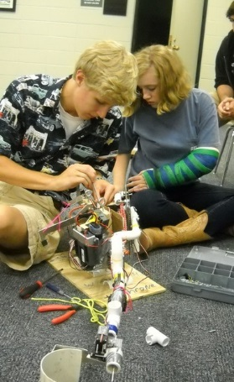
Thank You! Questions?
Contact Information:
Beverly Hilderbrand
CARCAM Director/PI
256-439-6871
bhilderbrand@gadsdenstate.edu
www.carcam.org

